Slide 1
Agentic Workflow Patterns
Author: Konrad Kowalczyk
Repository: ai-agents-JAVA-SPRING

Slide 2
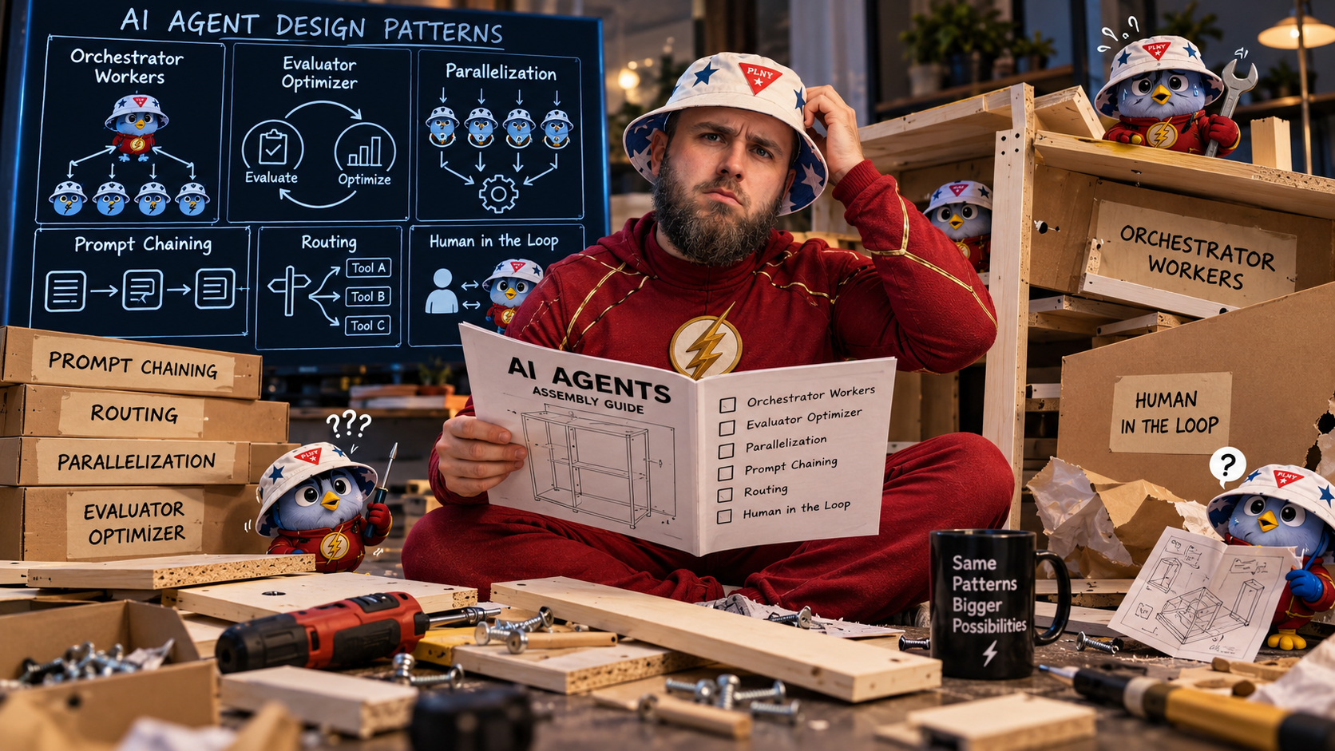
Agenda
Workflow or agent?
Two modules, one domain
Five patterns
  Prompt chaining
  Routing + human in the loop
  Parallelization
  Evaluator-optimizer
  Orchestrator-workers
Reading the traces
The DSL underneath

Slide 3
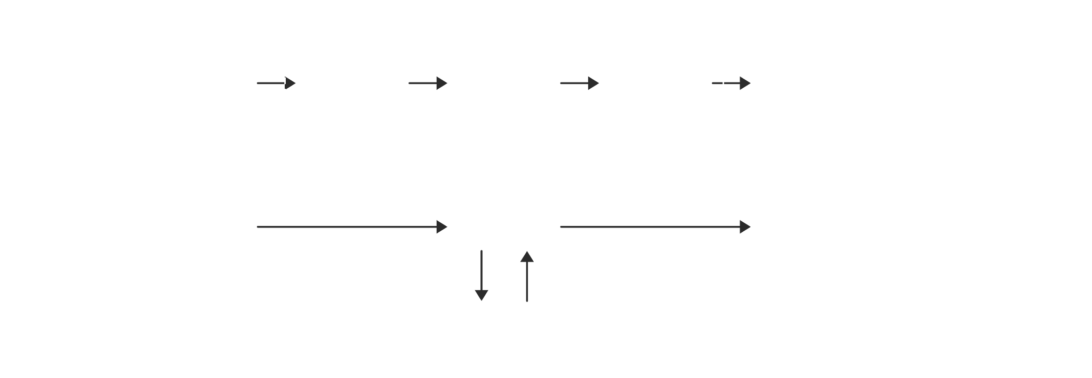
Workflow or agent?
In a workflow, your code.
Who decides the next step?
In an agent, the model.

Slide 4
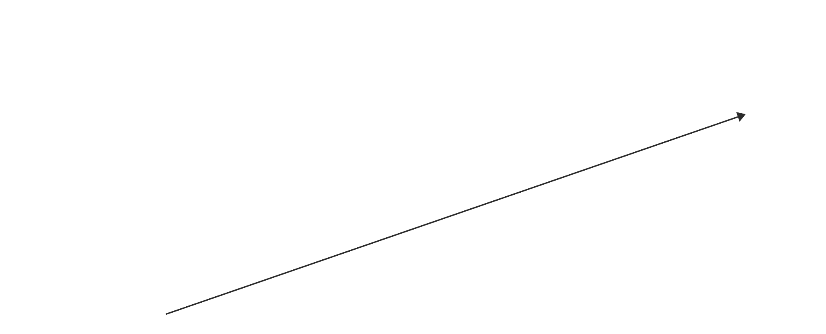
Climb only when you must
Find the simplest solution, and add complexity only when you need it.

Slide 5
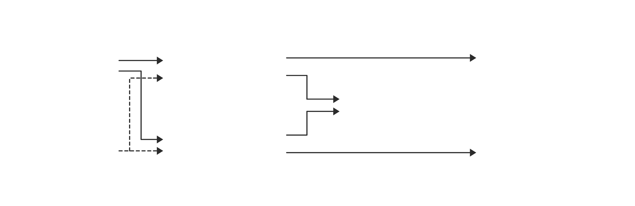
Two modules, one domain
Same five endpoints, same data, same four tools.
Only the framework changes.

Slide 6
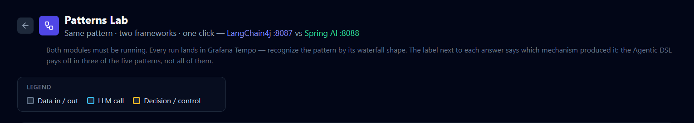
Patterns Lab
A page in the chat UI that sends the same request to LangChain4j and Spring AI at once.

Slide 7
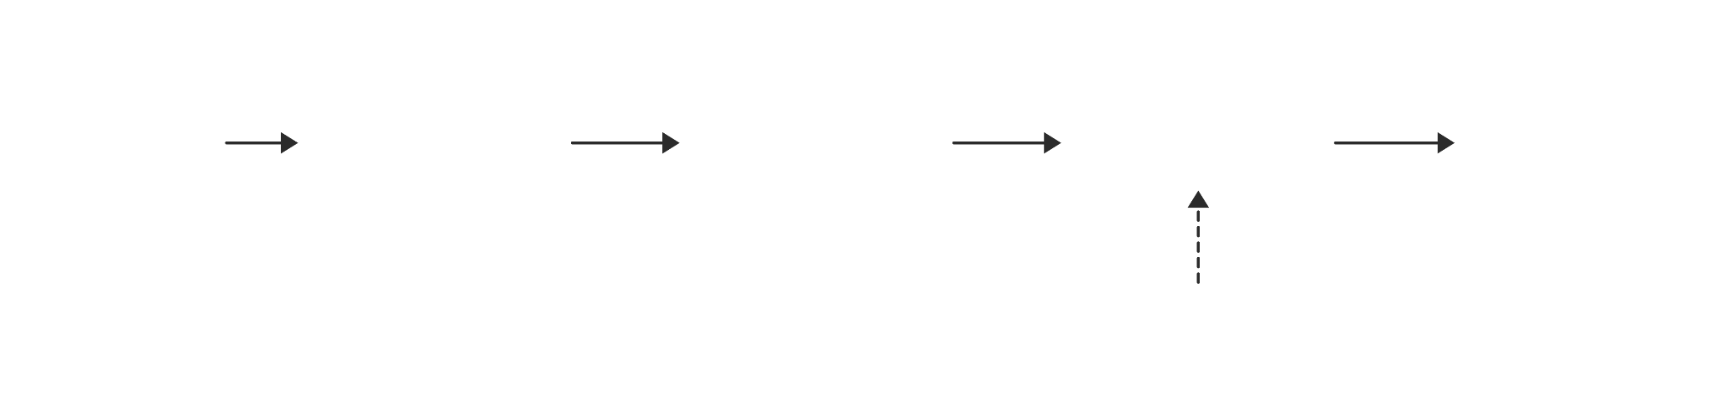
Prompt chaining
Break the task into steps.
Each step’s answer is pasted into the next step’s prompt.
No shared history, every step is a fresh call.

Slide 8
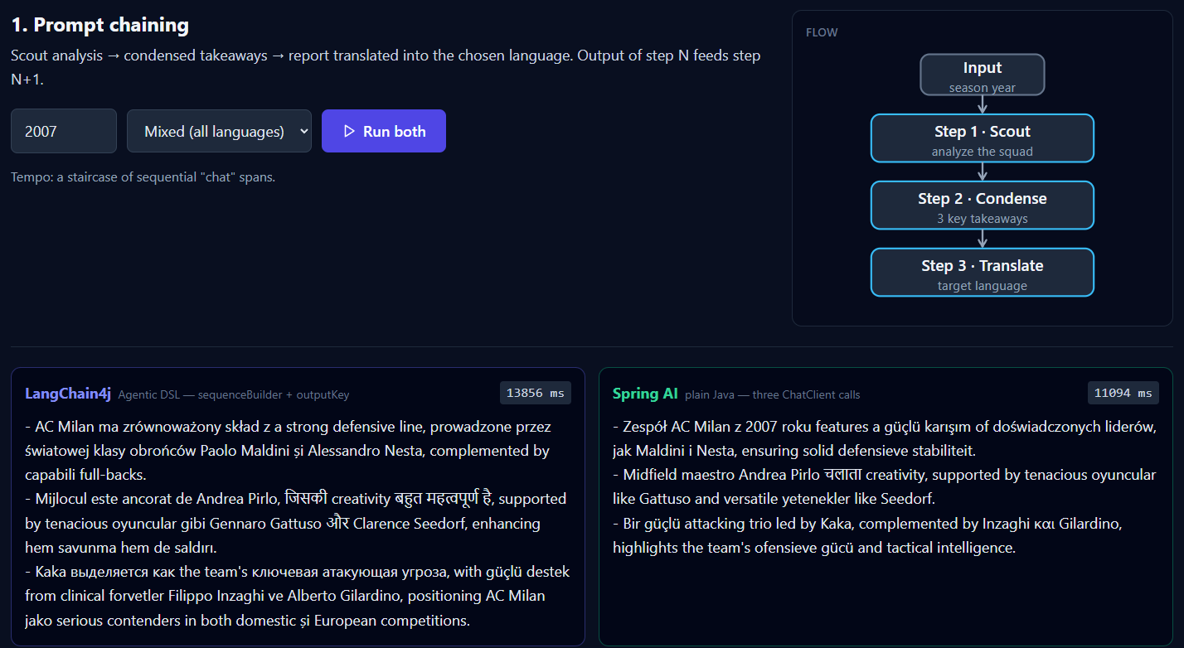
Results

Slide 9
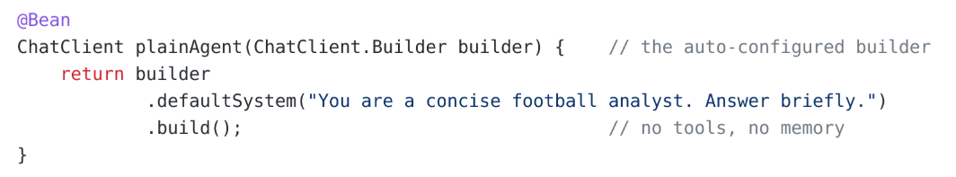
Prompt chaining → Spring AI
Plain Agent → no tools, no memory, the same system prompt on every step.

Slide 10
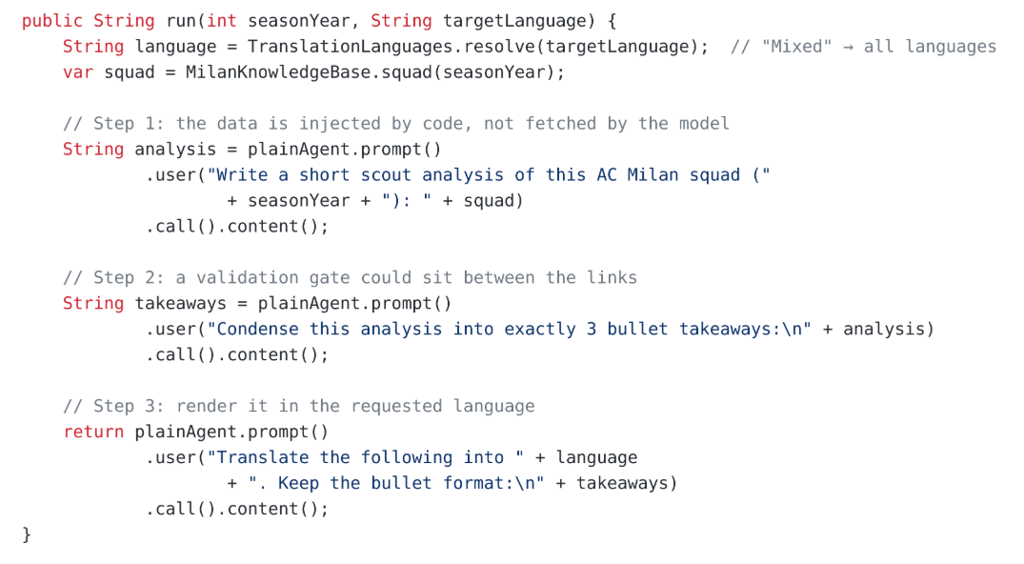
Three calls in a row

Slide 11
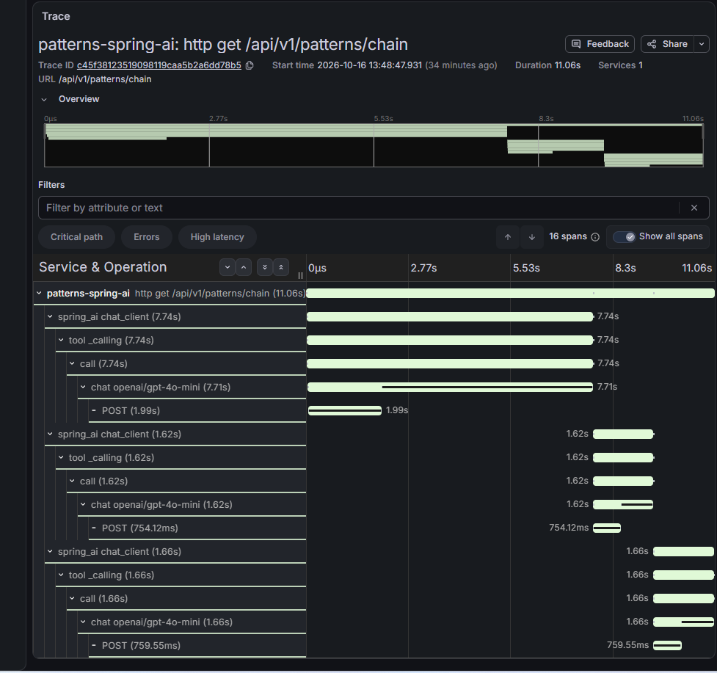
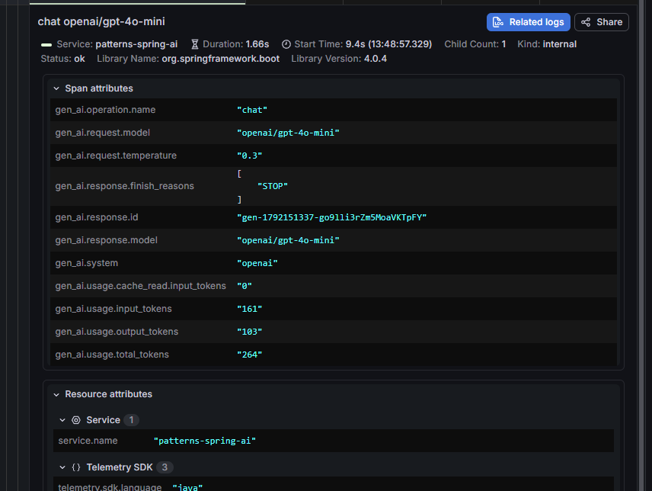
Trace
1
2
3

Slide 12
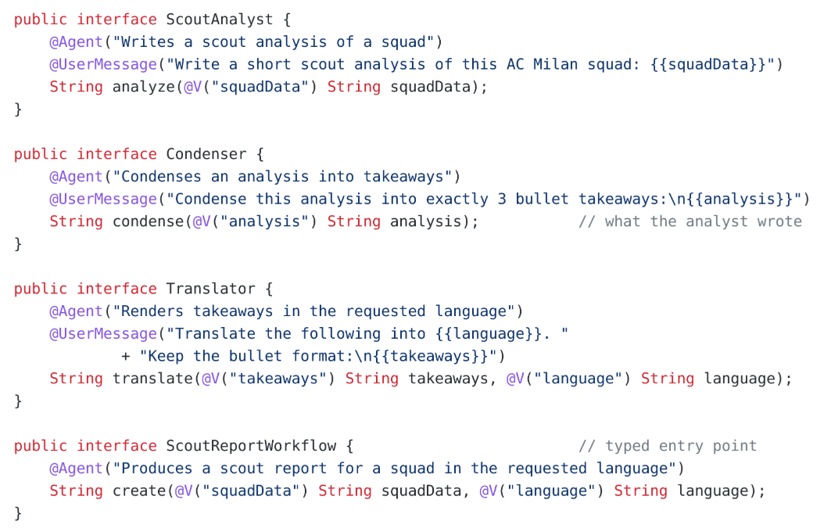
Prompt chaining → LangChain4j
required
not required *

Slide 13
@Agent vs @SystemMessage
@Agent → read by whoever calls the agent. It says what this agent is for. A supervisor reads it to pick an agent, the way a model reads a @Tool description.
@SystemMessage → read by the model inside the agent, on every call. It says who to be and which rules to follow.
Abstraction | Read by | Says
@Agent | the caller (a supervisor) | what this agent is for
@SystemMessage | the model, every call | who to be, which rules
@UserMessage | the model, every call | what to do with this input

Slide 14
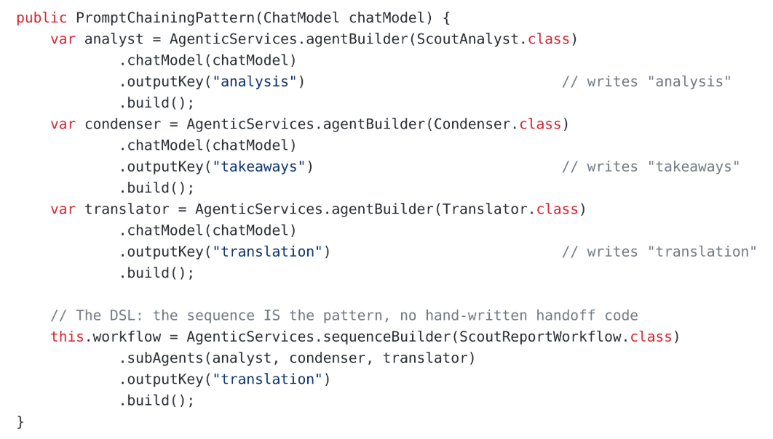
The sequence is declared

Slide 15

AiServices vs AgenticServices
AiServices → the framework runs the loop. One interface, one AI service.
AgenticServices → you declare the workflow. A planner picks the next agent.

Slide 16
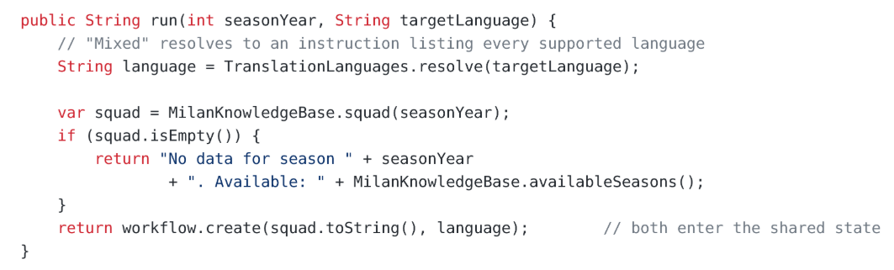
One call starts the whole chain

Slide 17
Agentic Scope
AgenticScope → one shared map per workflow call
writes → the arguments, then each agent’s outputKey
reads → every @V, every condition, the final result
history → every agent call, in order
lifetime → one call, or kept per @MemoryId
Keys are plain strings.
A typo fails at runtime.

Slide 18
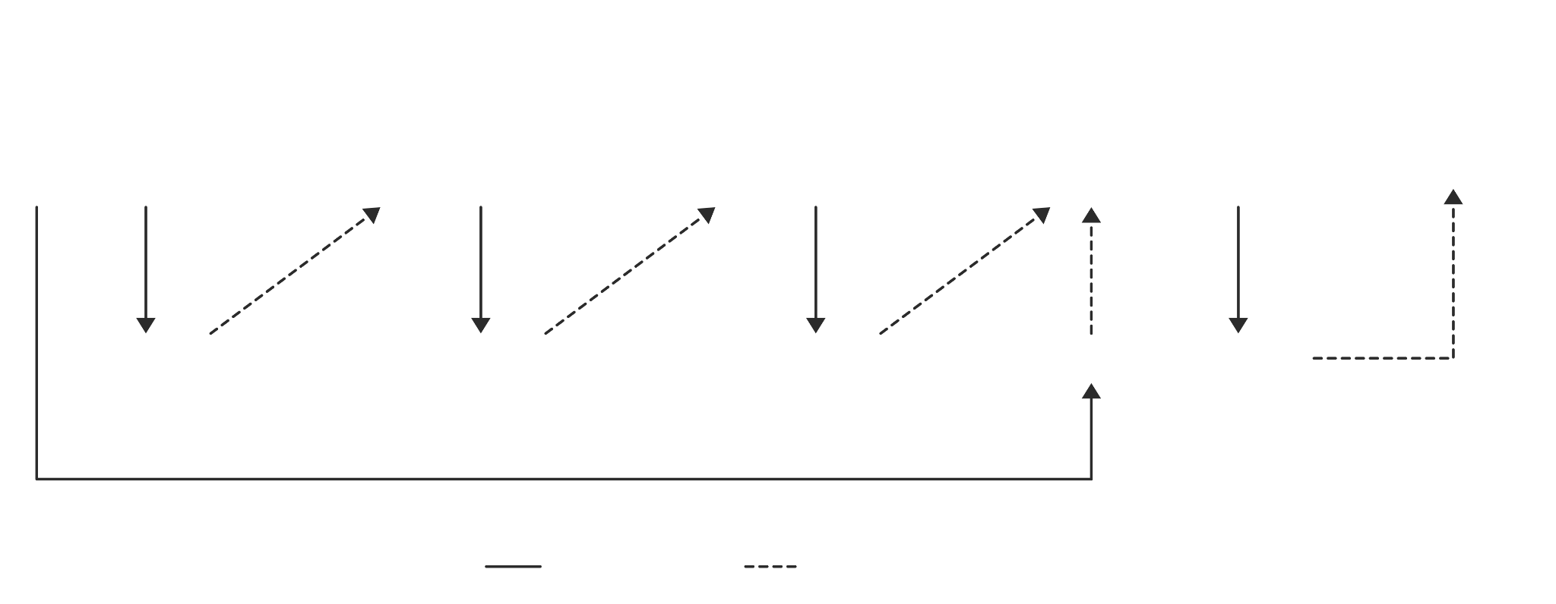
DSL “sequence ”

Slide 19
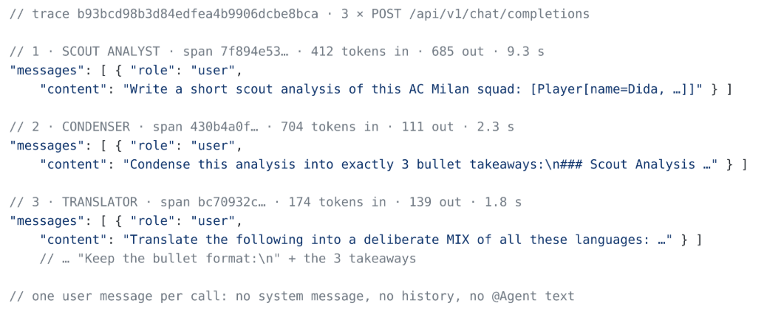
What the model actually sees

Slide 20
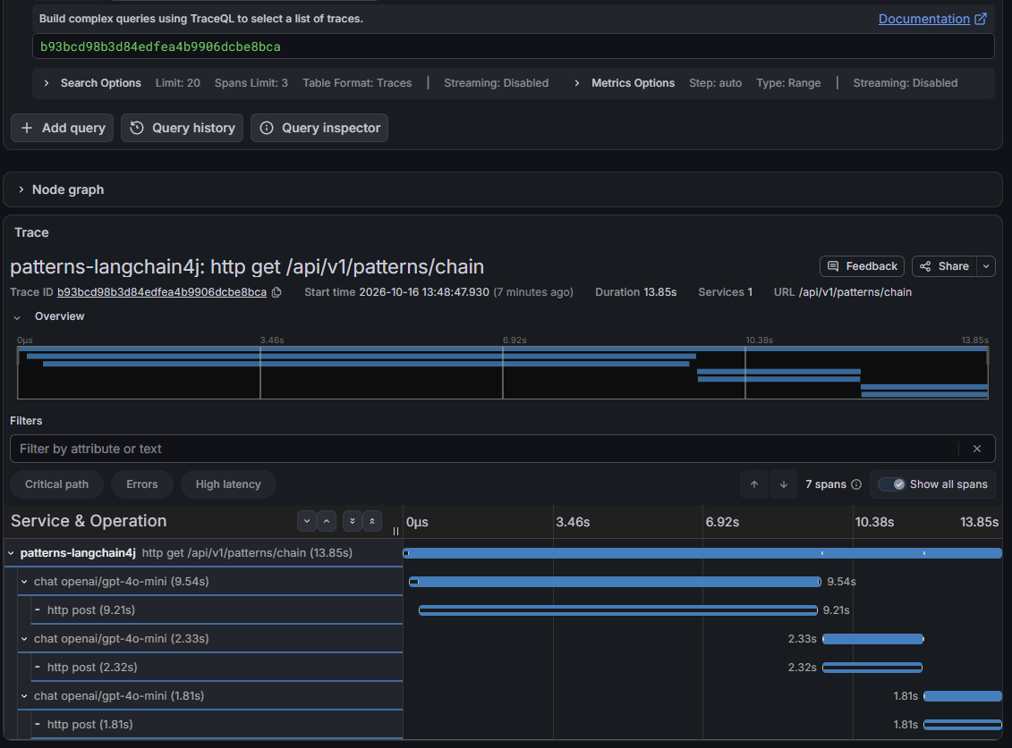
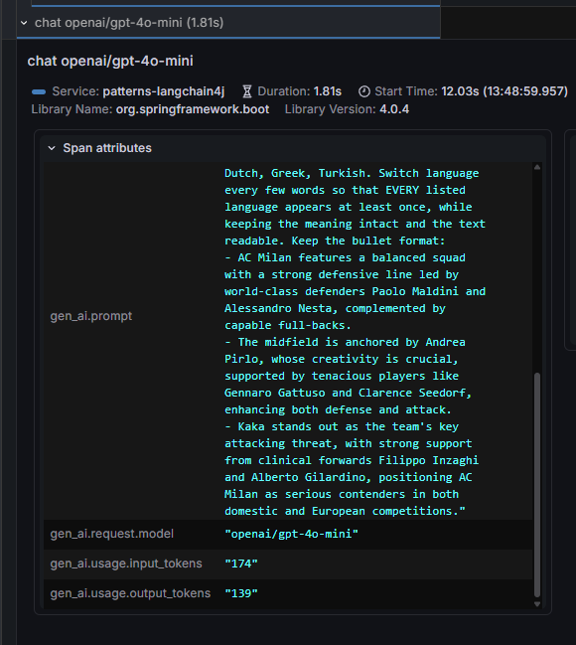
Trace
1
2
3

Slide 21
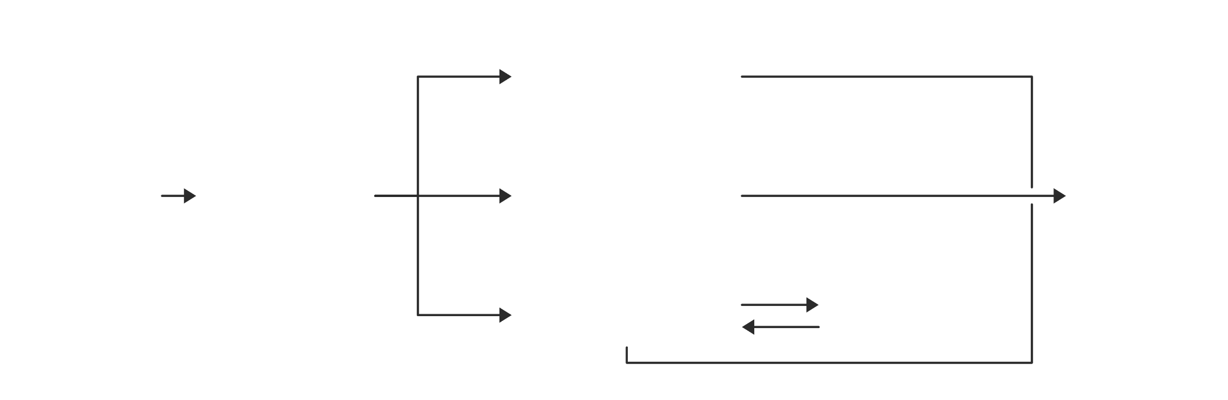
Routing
A cheap classifier picks the specialist.
It recognizes, it never answers.

Slide 22
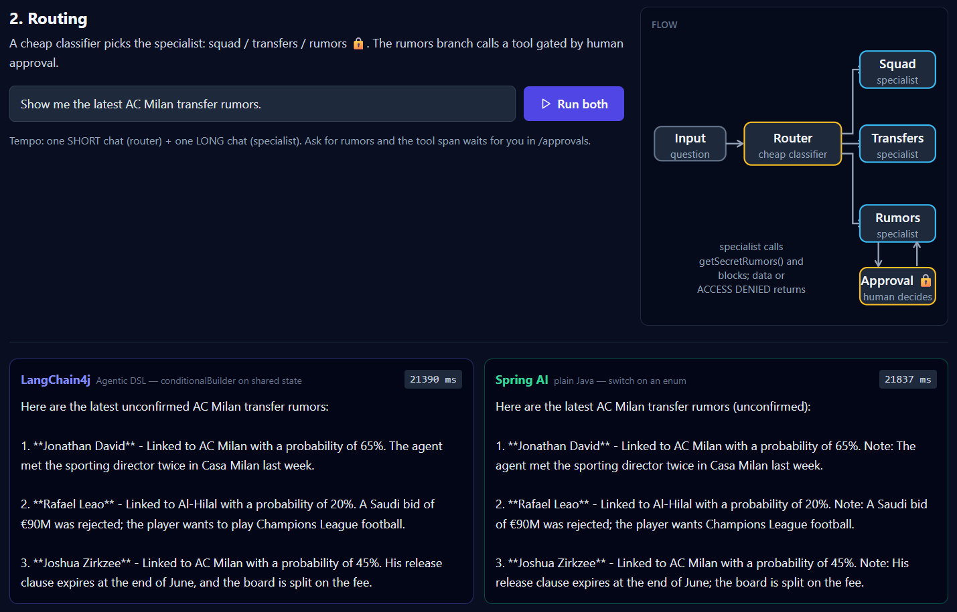
Results

Slide 23
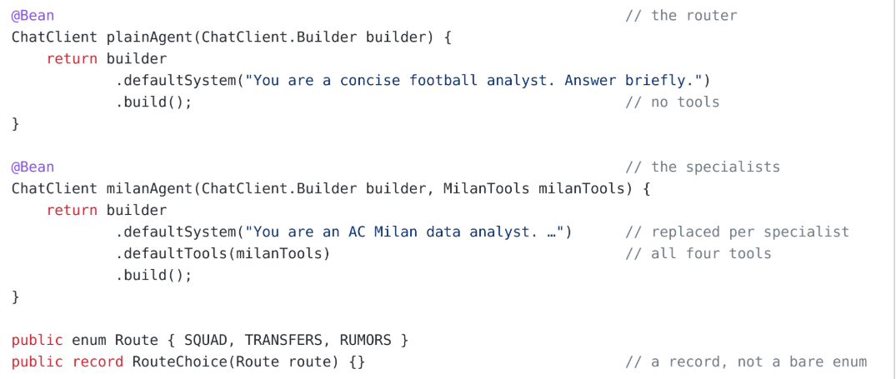
Routing → Spring AI
Two clients, two jobs
Plain Agent
Milan Agent
→ has no tools, so it can only recognize.
→ has all four tools and answers.

Slide 24
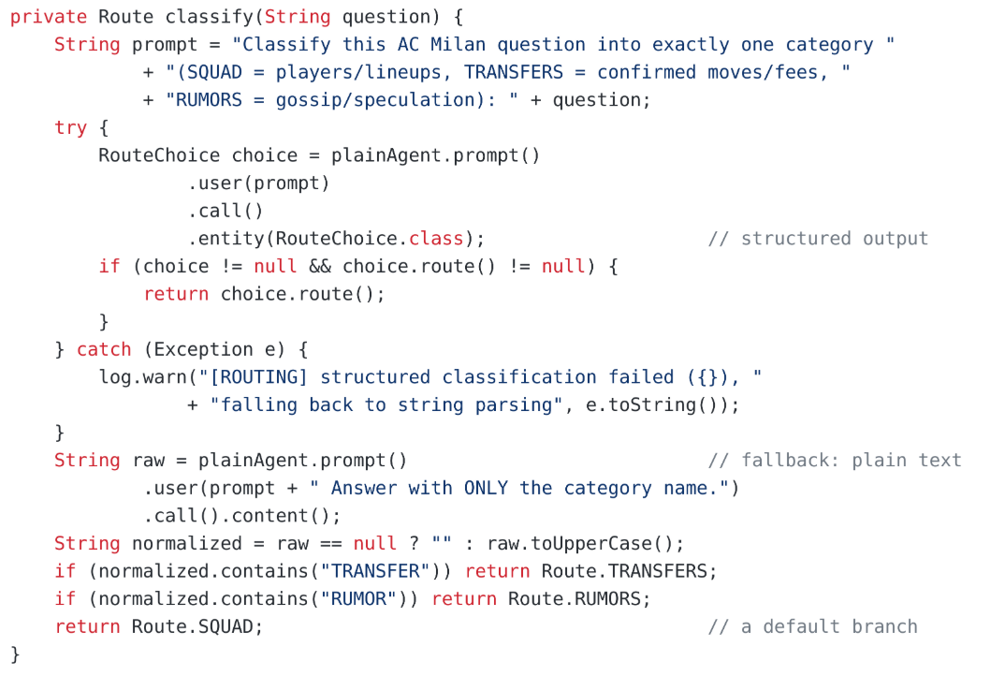
Classify, with a fallback

Slide 25
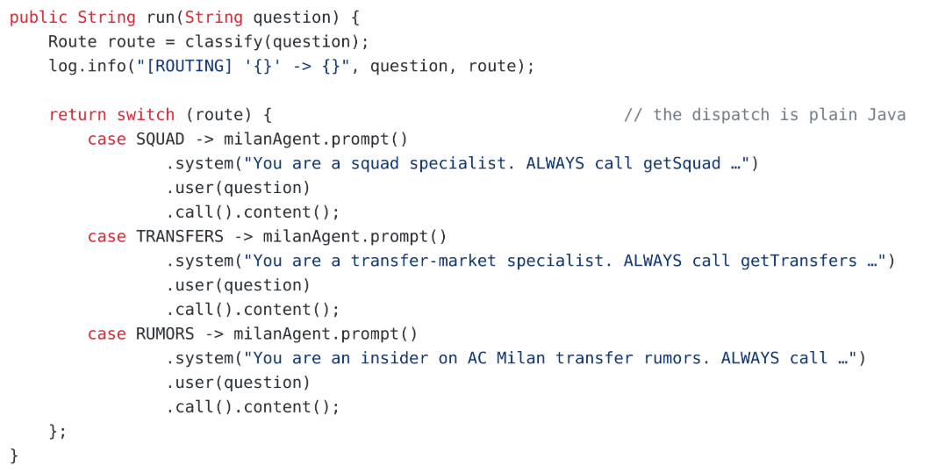
The dispatch is a switch

Slide 26
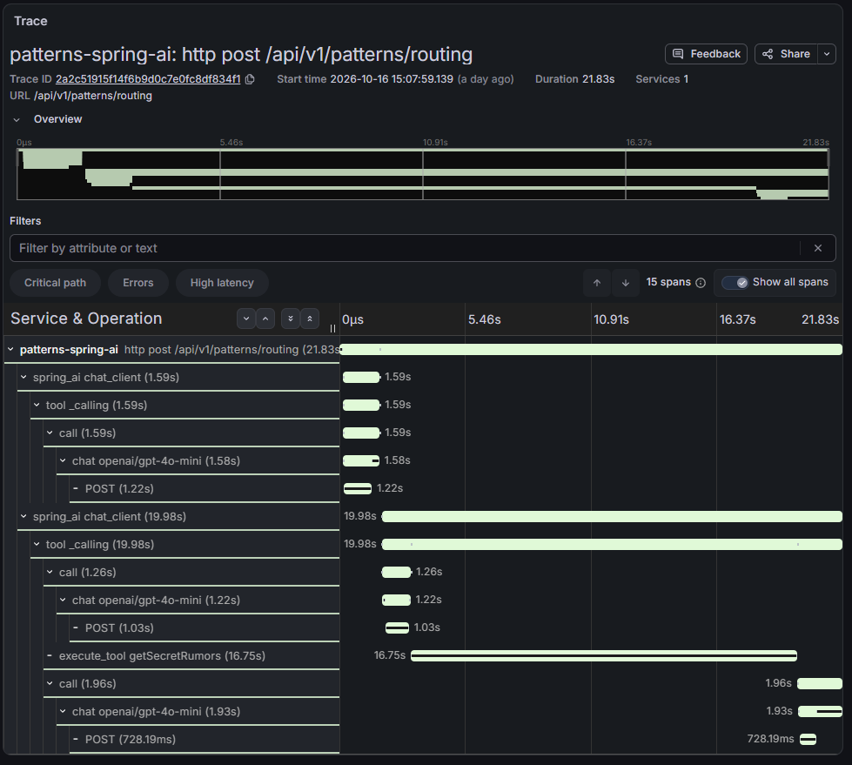
Trace
1
2

Slide 27
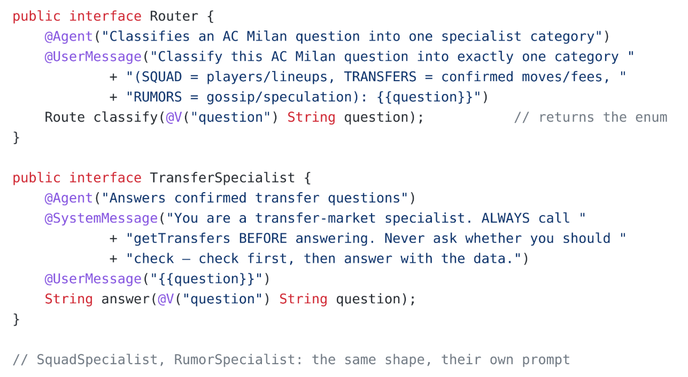
Routing → LangChain4j
One interface per role
The router returns an enum.
Each specialist adds a @SystemMessage.

Slide 28
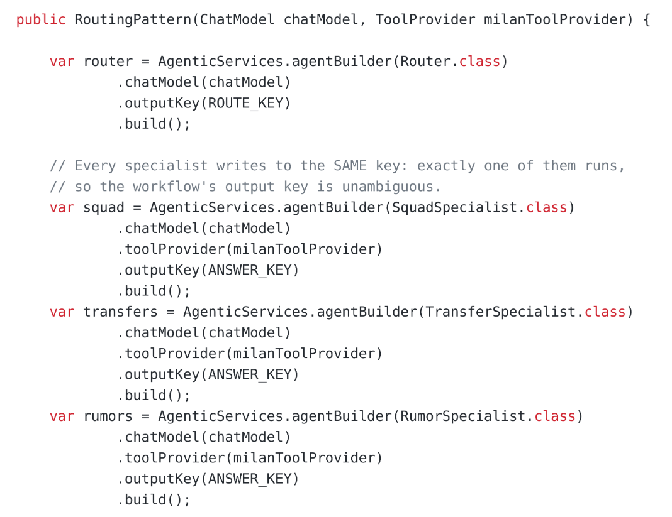
Every specialist writes the same key

Slide 29
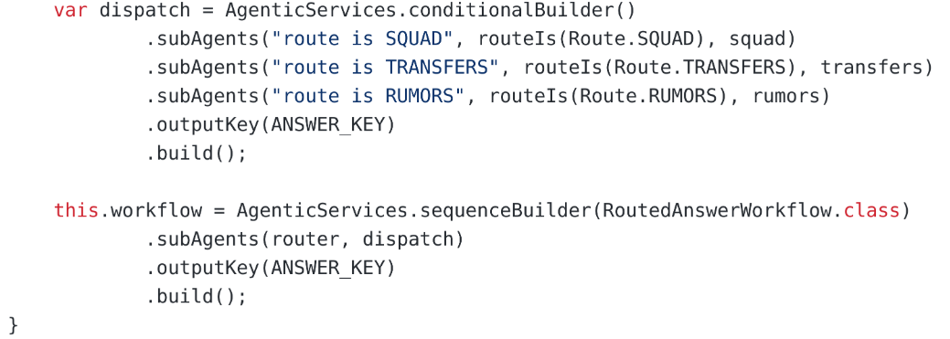
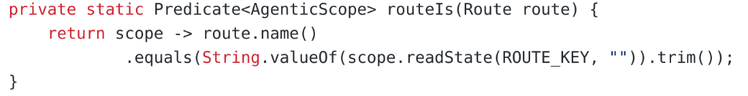
The branch is declared

Slide 30
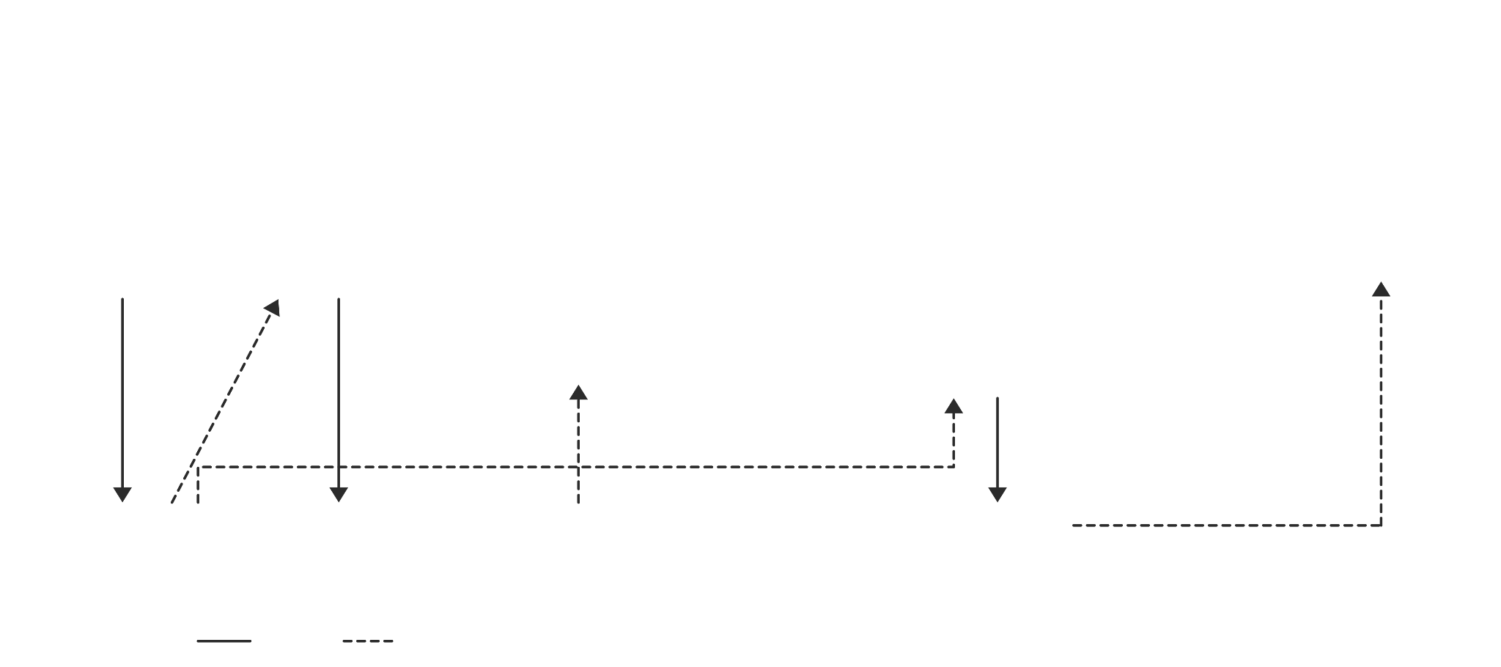
DSL “conditional”

Slide 31
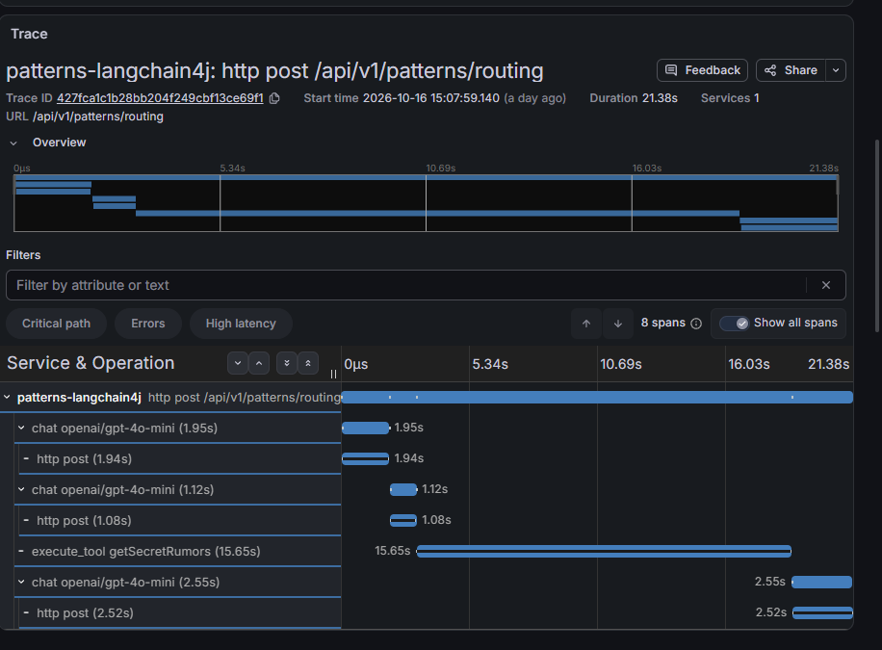
Trace
Why does it take so long?
1
2

Slide 32

Approval flow
Not a slow model.
A slow human.
but…
Some decisions are worth waiting for.

Slide 33
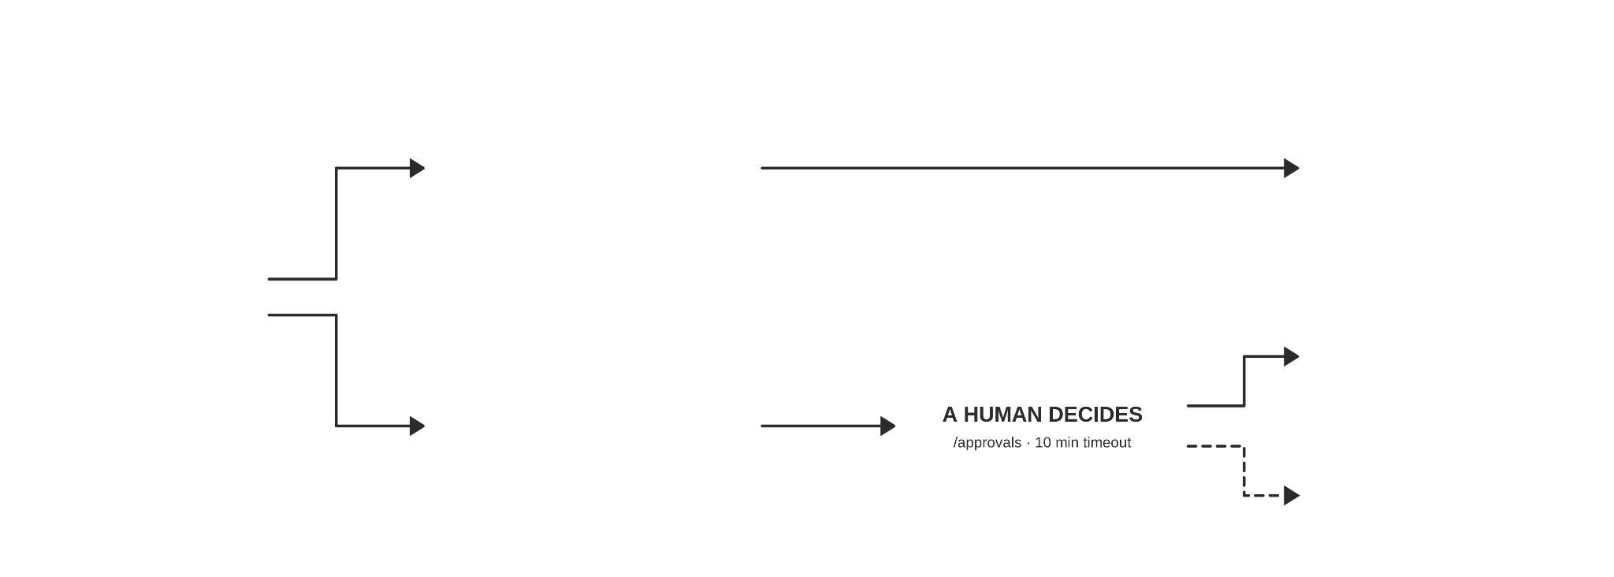
Human in the Loop
The model can ask, but only a human can approve.

Slide 34
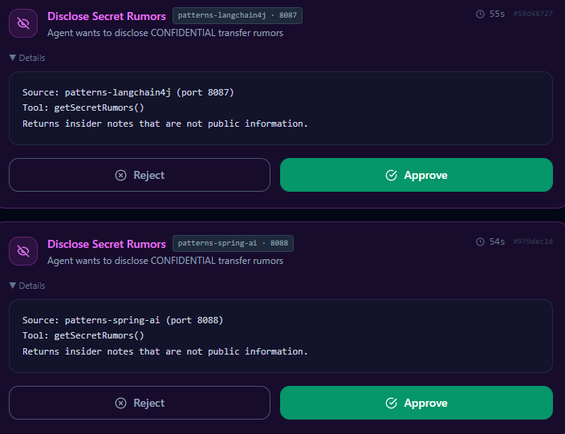
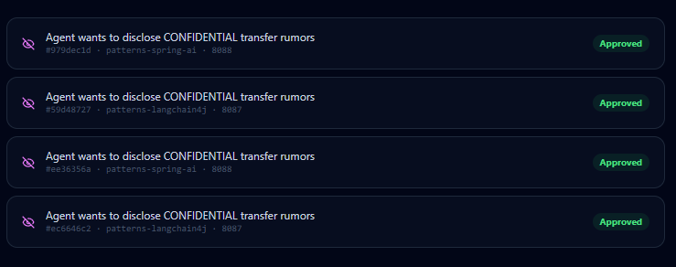
Critical operations need a human to review and approve them.

Slide 35
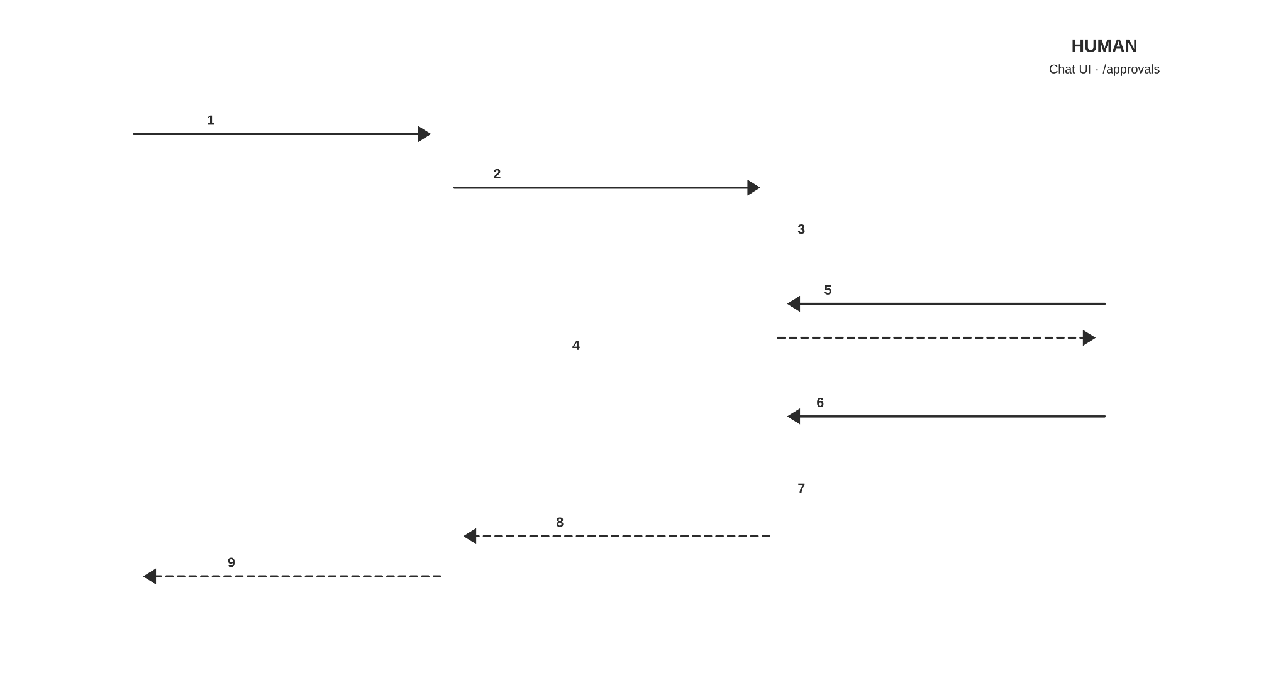
Schema

Slide 36
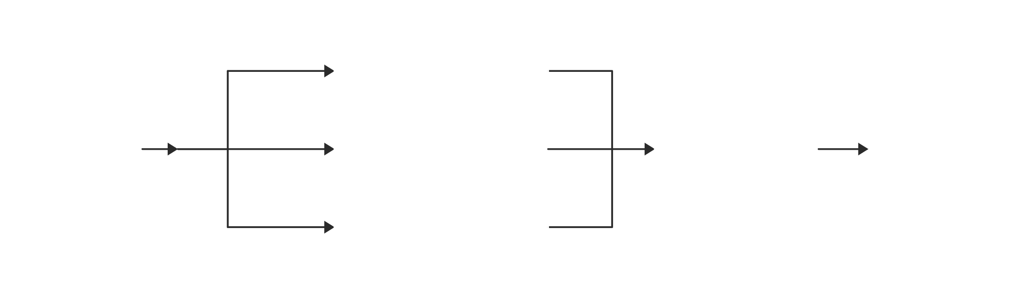
Parallelization
Every candidate is scored at the same time.
The code waits for all of them and picks the best.

Slide 37
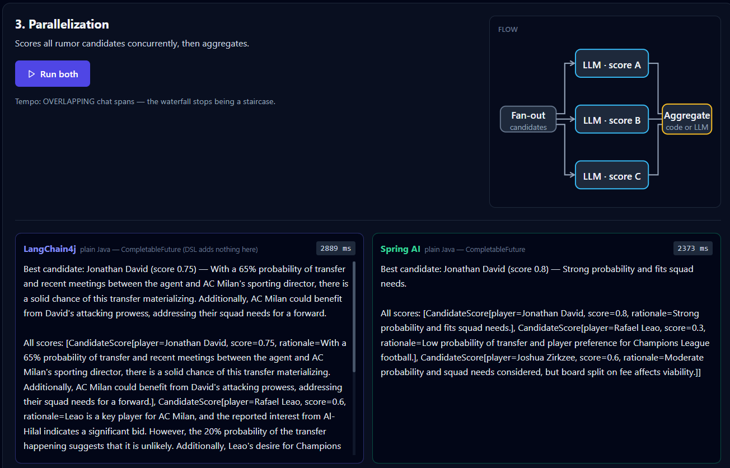
Results

Slide 38
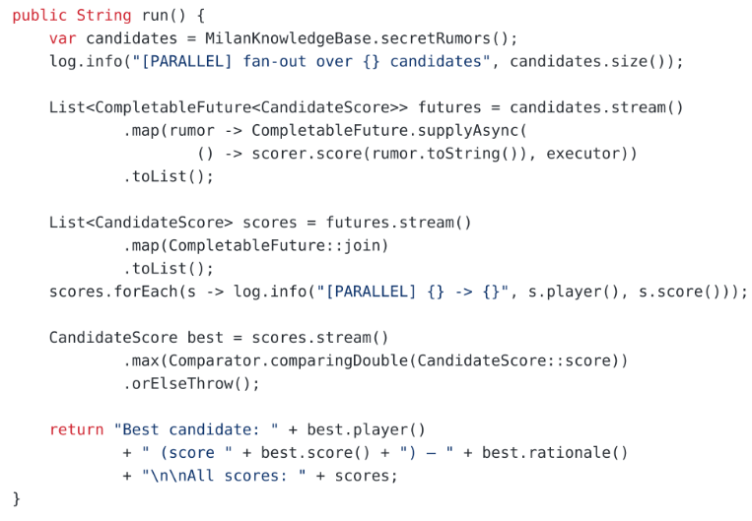
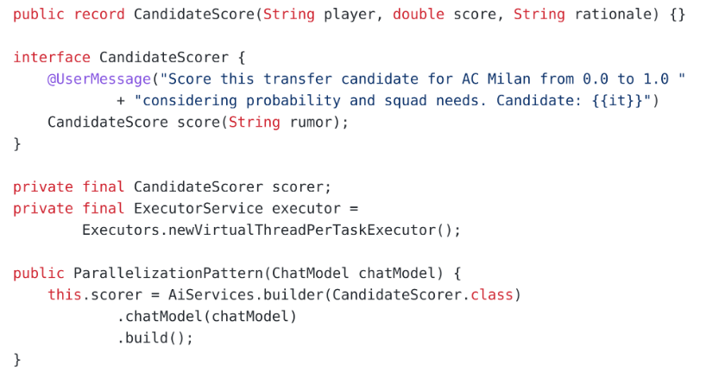
It’s quite simple
Both sides are plain Java + a model call.
LangChain4j

Slide 39
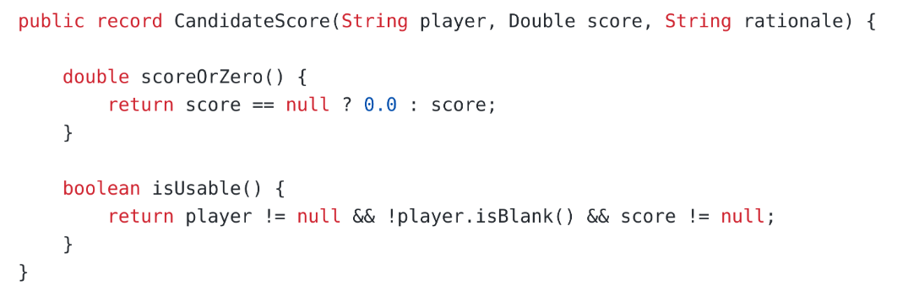
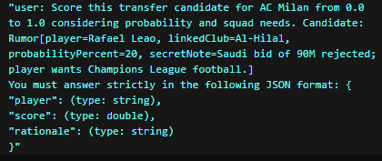
Let the model fill a record, let Java do the math
Ask the model for a record, not for text.
A model call costs time, money and a chance of a wrong answer.
Arithmetic costs none of them.

Slide 40
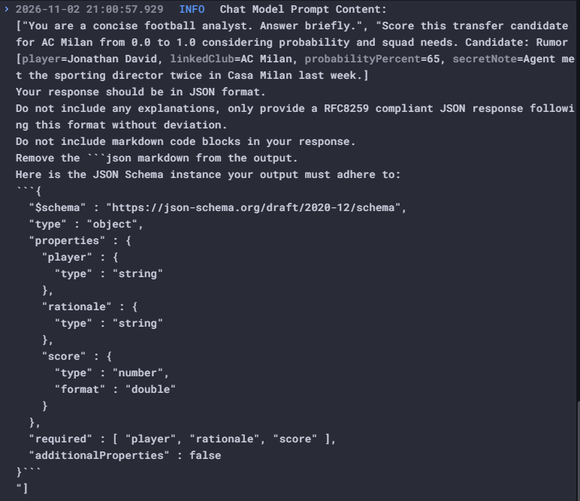
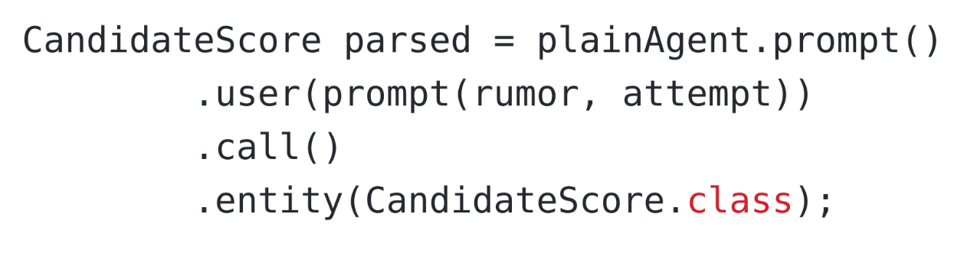
Spring AI entity

Slide 41
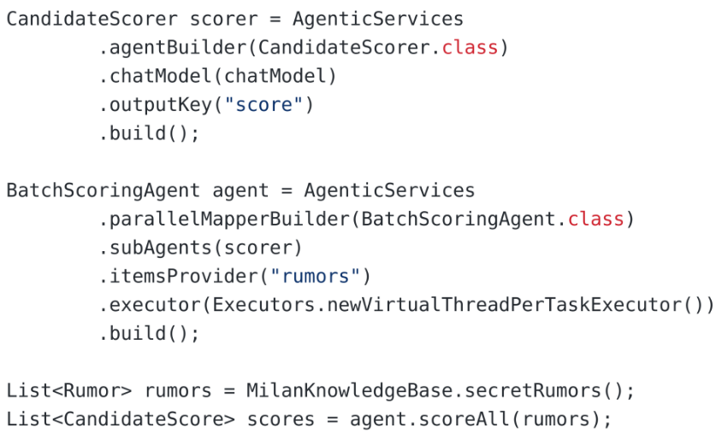
DSL… but why?
parallelBuilder
Agents and Agentic AI | LangChain4j
parallelMapperBuilder
Parallelization has no state and no condition to declare.
CompletableFuture does the same job and hides less.
The DSL can catch a crash. It can’t spot a wrong answer.

Slide 42
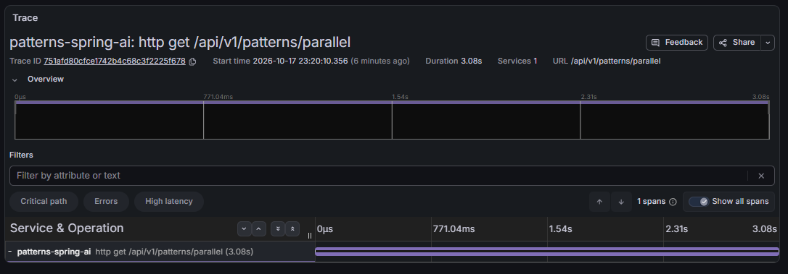
More Threads = More problems
Should be 3

Slide 43
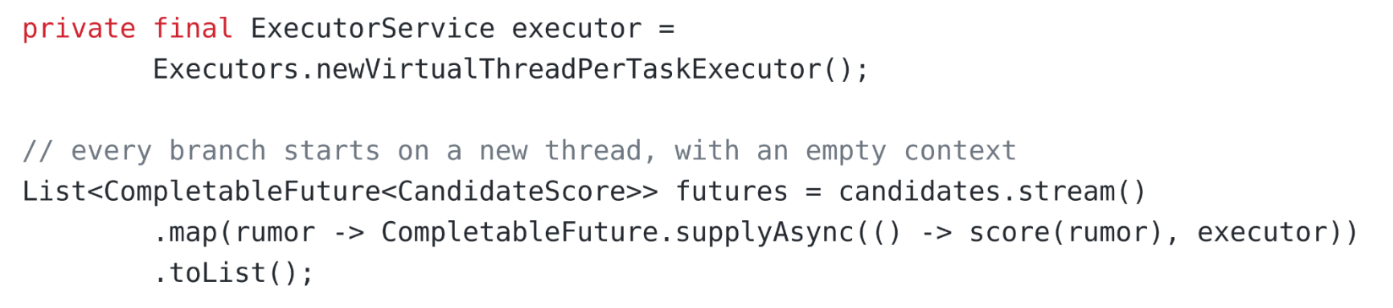
The Problem
The trace context lives in a ThreadLocal.
A new thread starts without it, so every branch opens its own trace.

Slide 44
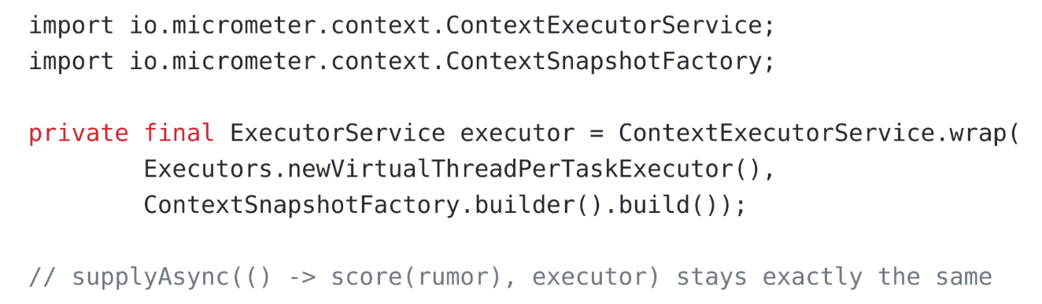
The Solution
Wrap the executor.
It copies the context into every task.

Slide 45
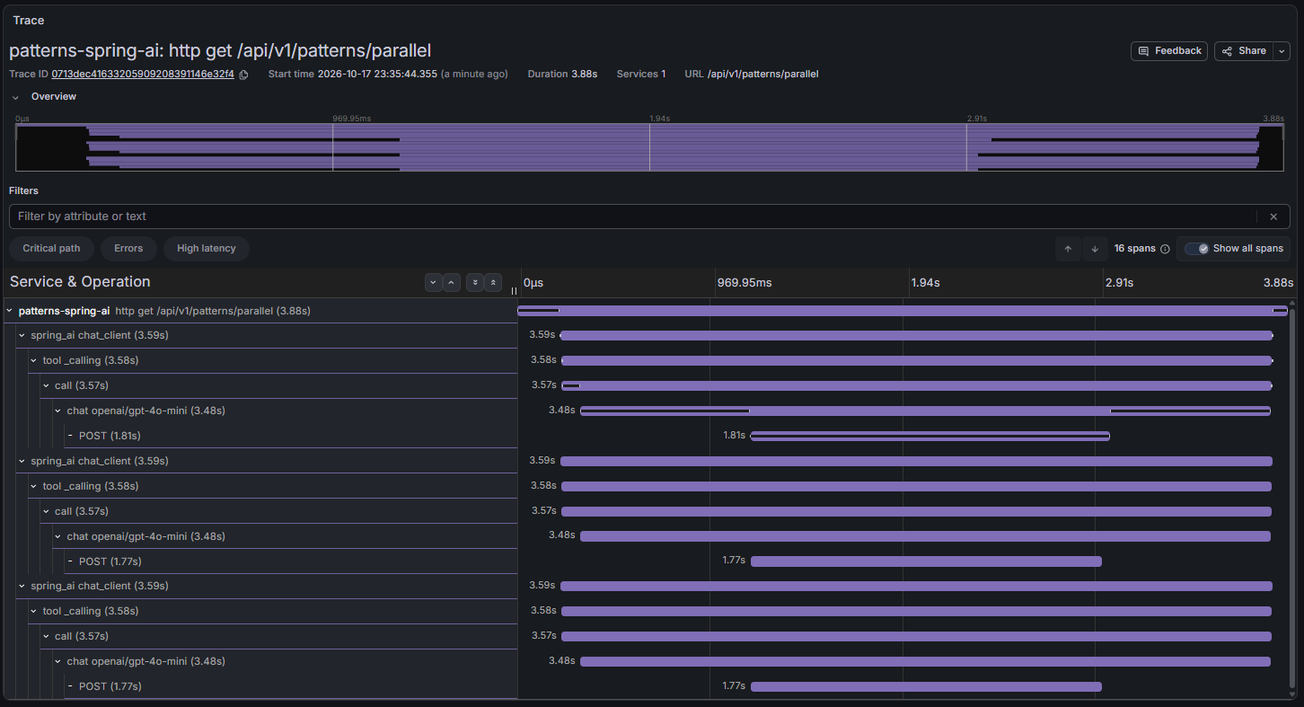
Fixed Trace

Slide 46
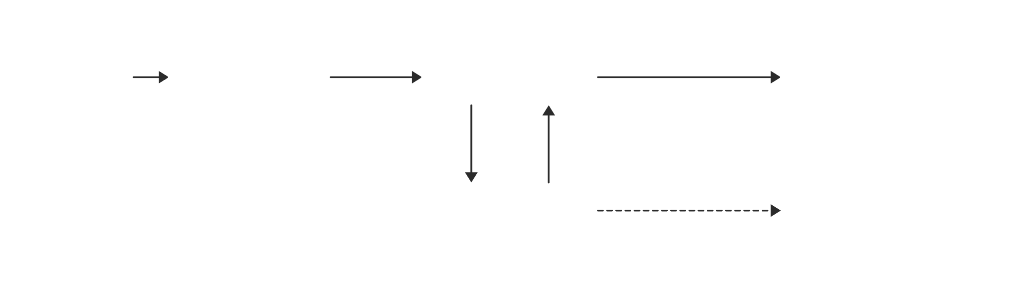
Evaluator-optimizer
One call proposes, one scores, one fixes.
Repeat until the score is good enough or the laps run out.

Slide 47
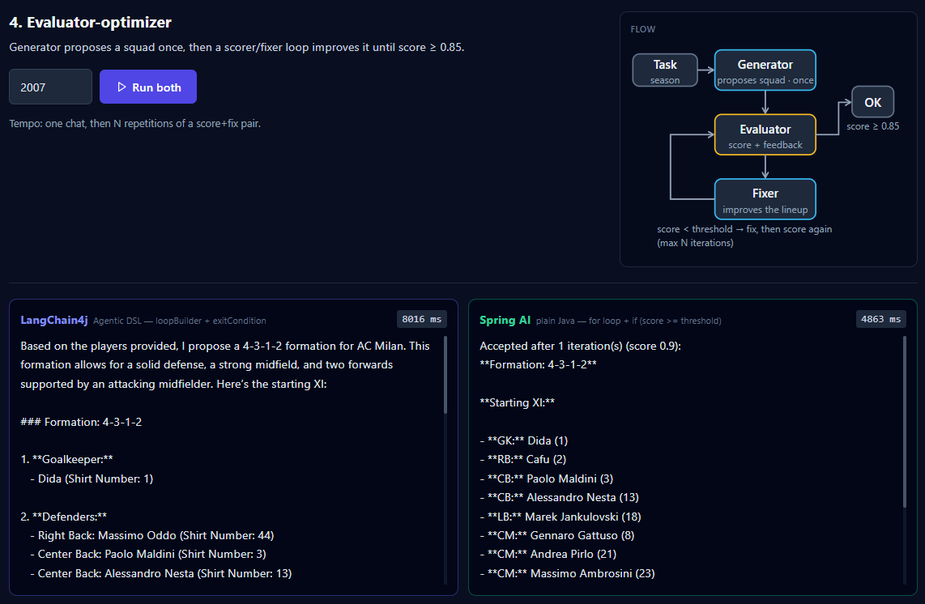
Results

Slide 48
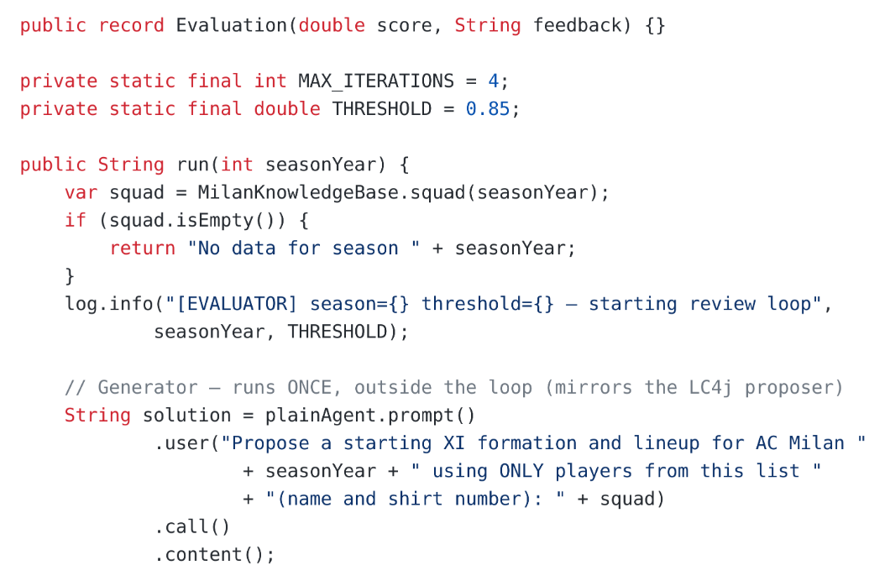
Evaluator-optimizer → Spring AI
The generator runs once, outside the loop.

Slide 49

Main Loop

Slide 50

Evaluator
The evaluator gets the rules and the squad, and returns a score with feedback.

Slide 51

Fix
The fixer improves the same lineup, guided by the evaluator’s feedback.

Slide 52


Trace

Slide 53

More accurate trace
1
2
3

Slide 54



Third time’s the charm

Slide 55

Evaluator-optimizer → LangChain4j

Slide 56

The fixer reads the feedback

Slide 57

Three agents, three keys

Slide 58

The loop is declared

Slide 59

Before, the fixer knew that the lineup failed.
Now it knows why.

Slide 60

The exit condition now reads the evaluation.

Slide 61

DSL “loop”
AgenticServices.loopBuilder() configures the loop.
A LoopPlanner runs it.

Slide 62


Trace

Slide 63

Orchestrator-workers
The model writes the plan at runtime.
You no longer know the branches.

Slide 64

Results

Slide 65

Orchestrator-workers → Spring AI

Slide 66

One worker call per subtask

Slide 67

One last call merges the results

Slide 68

Trace

Slide 69

Orchestrator-workers → LangChain4j

Slide 70

Three AI services, one job each

Slide 71

Plan, dispatch, synthesize

Slide 72

Trace

Slide 73

Every pattern leaves its own waterfall
Open the trace in Tempo and the shape tells you which pattern ran.

Slide 74

Same loop, three planners

Slide 75

Two ways to write a workflow
LangChain4j declares it.
Spring AI lets you write it.

Slide 76

See you in part Ⅲ next week!

